Slide 1
The Consumer Financial Protection Bureau (CFPB)
Consumer Complaint Analytics

Slide 2
Background
Bank of America’s CFPB complaint data from 2017–2023 contains valuable information about customer dissatisfaction across financial products, issues, and response types.
Without systematic analysis, trends in complaint volume, major sources of dissatisfaction, and potential gaps in response timeliness remain difficult to identify.

Slide 3
Objectives
This project analyzes complaint patterns to generate actionable insights that support better customer experience, regulatory compliance, and operational decision-making.

Slide 4
Result a. patterns in complaint
Complaint frequency remained relatively stable between 1,000 and 1,200 from January to June 2023, experienced sharp peak at 1,749 in July, and then dropped significantly to its lowest point at 717 in August

Slide 5
Products drive the most complaints
Bank accounts generated the highest volume of inquiries/complaints at over 4.000, while Loans accounted for the fewest in 2023

Slide 6
Issues the most complaints
Customer Service & Account Management was by far the leading issue category with over 3.500 cases, while Bank Accounts & Overdrafts saw the fewest reported issues

Slide 7
Complaints are resolved
A vast majority responses were timey at 78%, while 16% remain pending and only 6% were masked as not timely

Slide 8
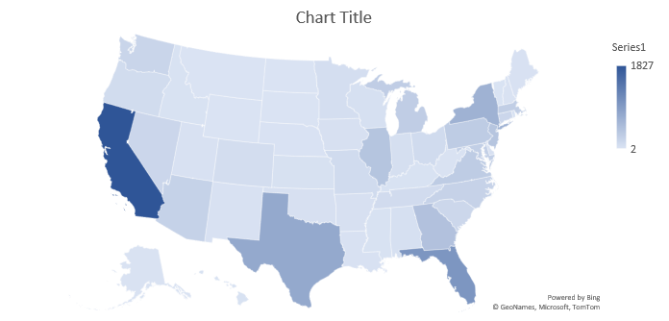
State with complaint

Slide 9
Drivers of untimely responses

Slide 10
Insight and Recommendation

